Slide 1
Mild respiratory COVID can cause multi-lineage neural cell and myelin dysregulation
Patricia Colom Díaz
Kimberly Heath
Chaewon Heo

Slide 2
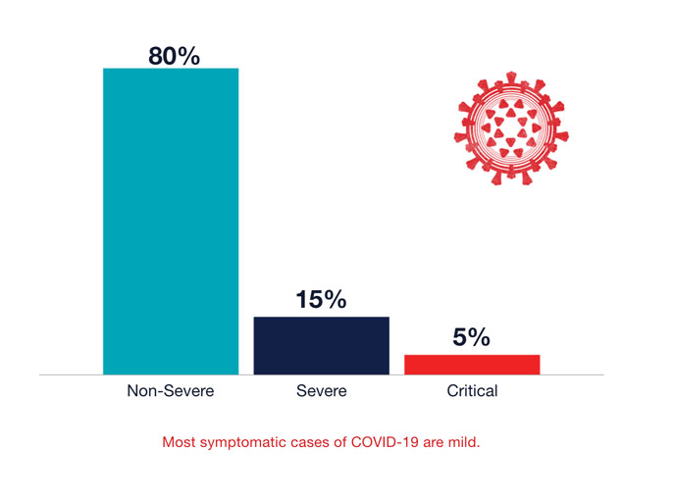
Majority of COVID-19 Cases Are Mild
Conrad, et al. USCF. 2021.

Slide 3
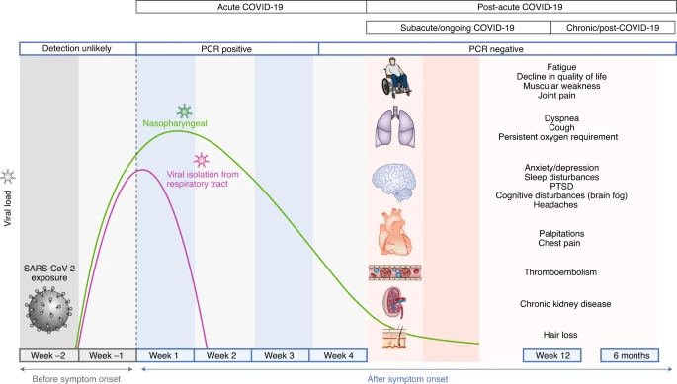
Long-term Effects of COVID-19 Infection
Nalbandian, A., Sehgal, K., Gupta, A. et al. Nat Met. 2021.
Notes:
Reference: https://www.nature.com/articles/s41591-021-01283-z

Slide 4
Main Research Question: What are the long-term neurological effects of mild COVID-19?

Slide 5
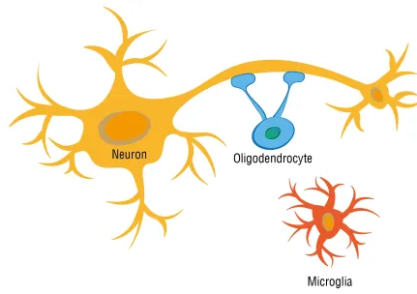
Overview of Neural Cells
Microglia- immune cells of the central nervous system.
Oligodendrocytes- responsible for maintenance and generation of the myelin sheath that surrounds axons.
Myelin Sheaths- is an insulating layer, or sheath that forms around nerves that allows electrical impulses to transmit quickly and efficiently along the nerve cells.
Kovacs GG. Handb Clin Neurol. 2017.

Slide 6
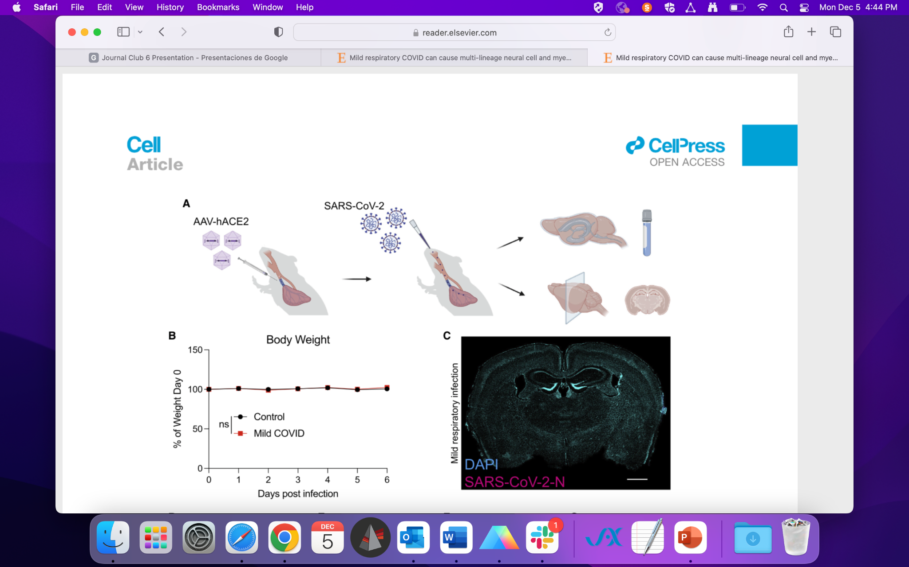
Figure 1. Mild respiratory COVID mouse model exhibits CSF cytokine/chemokine elevations

Slide 7
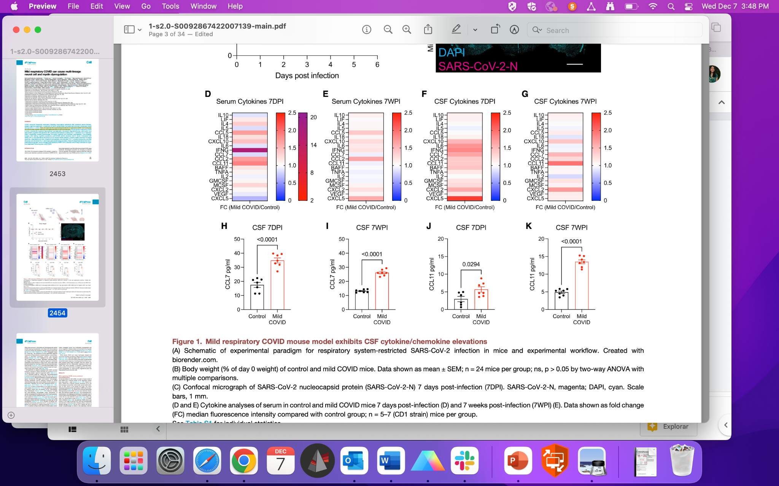
Figure 1. Mild respiratory COVID mouse model exhibits CSF cytokine/chemokine elevations

Slide 8
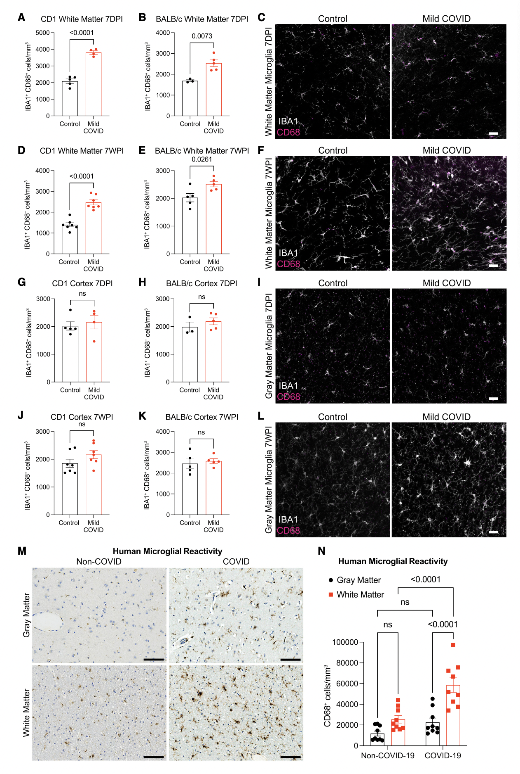
Figure 2. White matter microglial reactivity after mild respiratory COVID
White
Gray
Notes:
Fig 2: white matter microglial reactivity after mild respiratory covid
In the paper, authors hypothesized of increased microglial/macrophage reactivity in subcortical white matter
In the study they used two mouse strains with mild covid to test the hypothesis
Looked into microglial reactivity levels using IBA1 and CD68 (markers for microglia/macrophage activation) co-positivity
Each dot represents an individual mouse
Fig 2AB: white-matter (cingulum of the corpus callosum) specific microglia activation levels 7 days post infection for both mouse strains
CD1: n=5 for control, n=4 for covid
BALB/c: n=3 for control, n=5 for covid
Fig 2DE: white-matter specific microglia activation levels 7 weeks post infection for both mouse strains
CD1: n=7 for control, n=7 for covid
BALB/c: n=5 for control, n=5 for covid
General trend:
Significant increase in microglial reactivity for the covid group in both 7 days post infection and 7 weeks post infection compared to the control group
Next step:
Measured reactivity also in cortical gray matter, but did not show as much of an increase than it was in white matter
—----
Fig 2/3/4 - Chaewon
2 mouse strains - CD1 and BALB/c
Hypothesis: increased microglial/macrophage reactivity in subcortical white matter
Results followed the hypothesis for both strains, as assessed by IBA1 and CD68 (markers for microglia/macrophage activation) co-positivity
IBA1: macrophage-specific calcium-binding protein
CD68: glycosylated type I transmembrane glycoprotein associated with endosomal/lysosomal compartment
Fig 2AB: white-matter specific microglia activation levels 7 days post infection for both mouse strains
CD1: n=5 for control, n=4 for covid
BALB/c: n=3 for control, n=5 for covid
Fig 2DE: white-matter specific microglia activation levels 7 days post infection for both mouse strains
CD1: n=7 for control, n=7 for covid
BALB/c: n=5 for control, n=5 for covid
Fig 2FH: grey-matter specific microglia activation levels 7 days post infection for both mouse strains
CD1: n=5 for control, n=4 for covid
BALB/c: n=3 for control, n=5 for covid
Fig 2JK: grey-matter specific microglia activation levels 7 days post infection for both mouse strains
CD1: n=5 for control, n=4 for covid
BALB/c: n=3 for control, n=5 for covid

Slide 9
Figure 2 (cont.)
White
Gray
Notes:
Micrographs of reactive microglial levels in white and gray matter:
IBA1 and CD68 (markers for microglia/macrophage activation) co-positivity
White: IBA1 (marker for microglial activation)
Magenta: CD68 (marker of inflammation associated with the involvement of monocytes/macrophages)
White matter (cingulum of the corpus callosum) in BALB/c mice:
Fig 2C: reactive microglia in cingulum 7 days post infection
Fig 2F: reactive microglia in cingulum 7 weeks post infection
Can see evident increase in reactive microglia by the increase in expression of CD68
Gray matter (cortical gray matter of BALB/c mice):
Fig 2I: reactive microglia in cingulum 7 days post infection
Fig 2L: reactive microglia in cingulum 7 weeks post infection
Can see evident increase in reactive microglia by the increase in expression of CD68
—-
In contrast to subcortical white matter, microglial and macrophage reactivity was not observed in the cortical gray matter

Slide 10
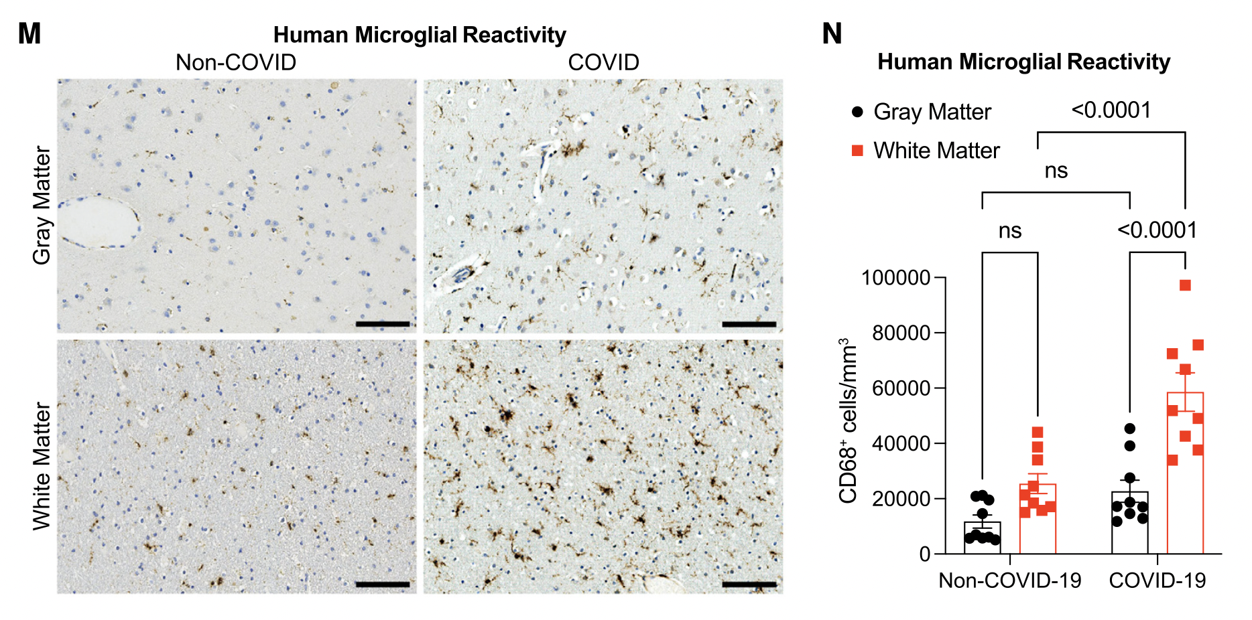
Figure 2 (cont.)
Notes:
Team also measured human microglial reactivity
noncovid
Samples: n=9 (9 male, age 43-84)
covid
Samples: n=9 (7 male, 2 female, age 24-73)
Nasal swab pcr of original covid strain
—-
Fig 2MN: robustly elevated CD68+ marker levels in subcortical white matter compared with cortical gray matter in infected individuals
M: Representative micrographs of CD68 immunostaining (brown) in the gray (cerebral cortex) or subcortical white matter of human subjects with COVID or in non-COVID control subjects.

Slide 11
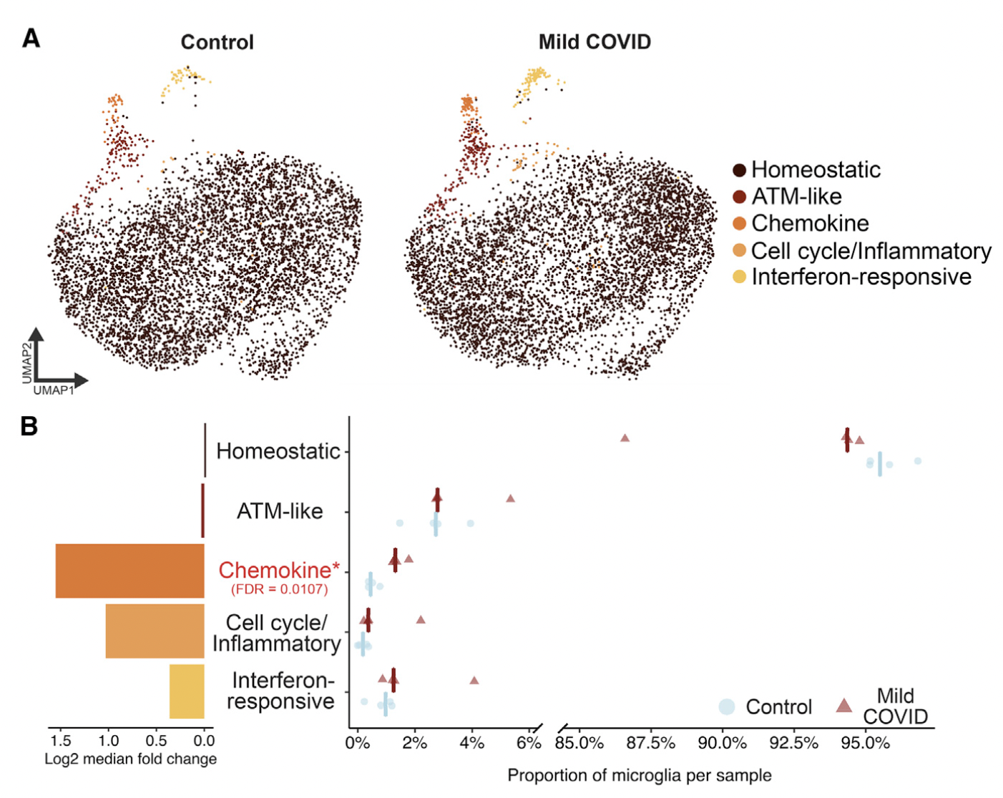
Figure 3. Microglia exhibit heterogeneous transcriptional changes after mild respiratory COVID
Notes:
Single-cell transcriptomic profiling of microglia after mild respiratory COVID in mice
Found: Covid mice exhibited increased abundance of chemokine-enriched microglia
——
Fig 3A: UMAP of microglial state clusters
n=4/group, approx ~6k single microglial cells/group
Clustering the cells revealed 5 distinct microglial states
Homeostatic cluster defined by higher expression of microglia-specific genes (P2ry12 / Tmem119)
Axon tract microglia resembling cluster with increased expression of Apoe, Cd63, Lpl
Chemokine-expressing cluster (ccl2, ccl4, ccl3, cxcl10)
Cluster enriched in inflammation-related genes (mcm3/4/6)
Cluster expressing interferon-responsive genes (ifit3, ifit2, Isg15)
Each states detectable in both control/covid mice
Fig 3B:
Left side:
Calculated log2 fold changes, positive fold change indicates higher proportion in covid samples
Greatest increase in chemokine subcluster
Right side:
Quantification of actual proportion of microglia
—
Covid mice exhibited increased abundance of chemokine-enriched microglia

Slide 12
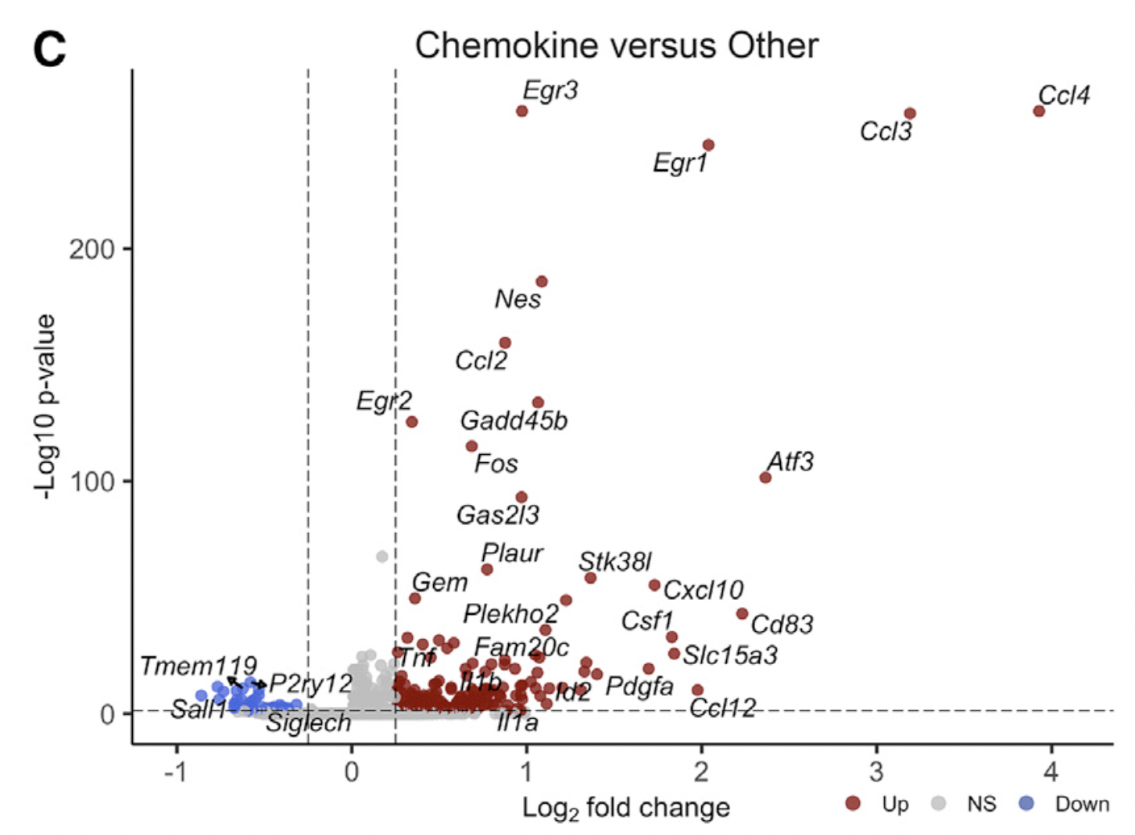
Figure 3 (cont.)
Inflammatory Cytokines
Tnf
Il1a
Il1b
…
Notes:
Cluster: chemokine
Differential expression testing between chemokine cluster microglia and all other microglia
Fig 3C: volcano plot of chemokines
Log2 fold change + 2 sided wilcoxon rank-sum test with bonferroni correction for p-values (fold change=0.25, adjp=0.05)
You see striking subpopulation of cells characterized by expression of several inflammatory chemokines and cytokines like Tnf, Il1a, Il1b
Consistent with an inflammatory reactive response of mild covid

Slide 13
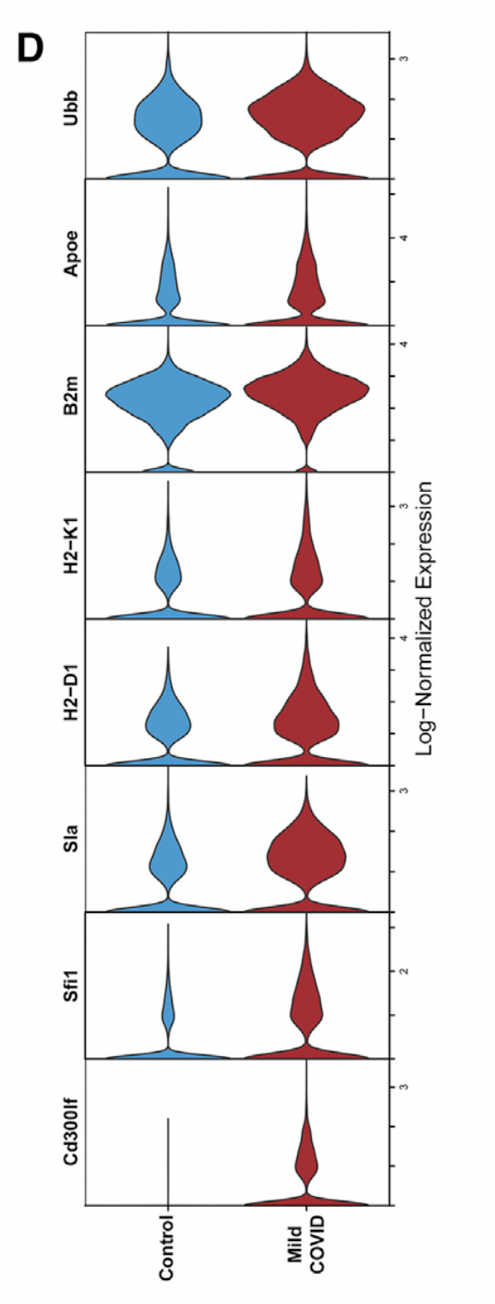
Figure 3 (cont.)
Notes:
Maybe take this out????
—----
Cluster: homeostatic
Fig 3D: Violin plot illustrating expression of 8 genes upregulated in homeostatic cluster microglia from mild COVID samples compared with controls
Looking at the transcriptional changes within the homeostatic cluster, there is increased expression of genes commonly upregulated in inflammation and involved in antigen processing and presentation (Bm2, H2-1, H2-K1, Cd300lf - all involved in regulation of immune responses and may regulate phagocytosis of apoptotic cells and maintain immune homeostasis)

Slide 14
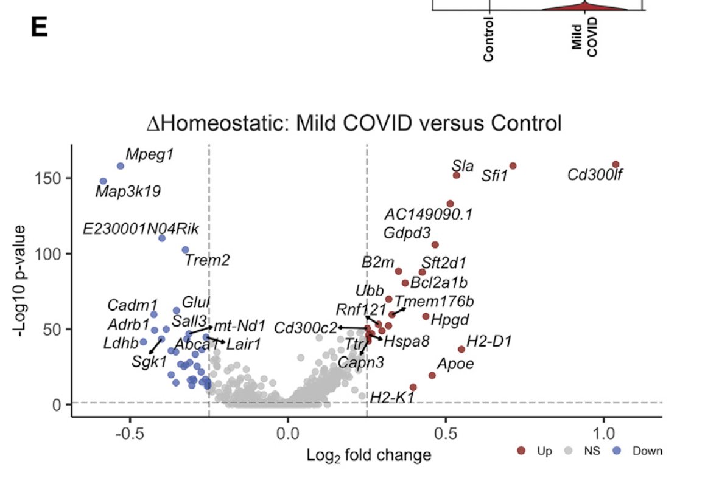
Figure 3 (cont.)
Genes known to be downregulated in aging white matter
Trem2
Sall3
Adrb1
…
Notes:
Fig 3E: Volcano plot illustrating results of differential expression testing between homeostatic cluster microglia from covid samples compared with controls
Log2 fold change + 2 sided wilcoxon rank-sum test with bonferroni correction for p-values (fold change=0.25, adjp=0.05)
Exhibit downregulation of characteristic microglial genes such as Trem2 and Sall3 and Adrb1 (gene known to be downregulated in aging white matter)

Slide 15
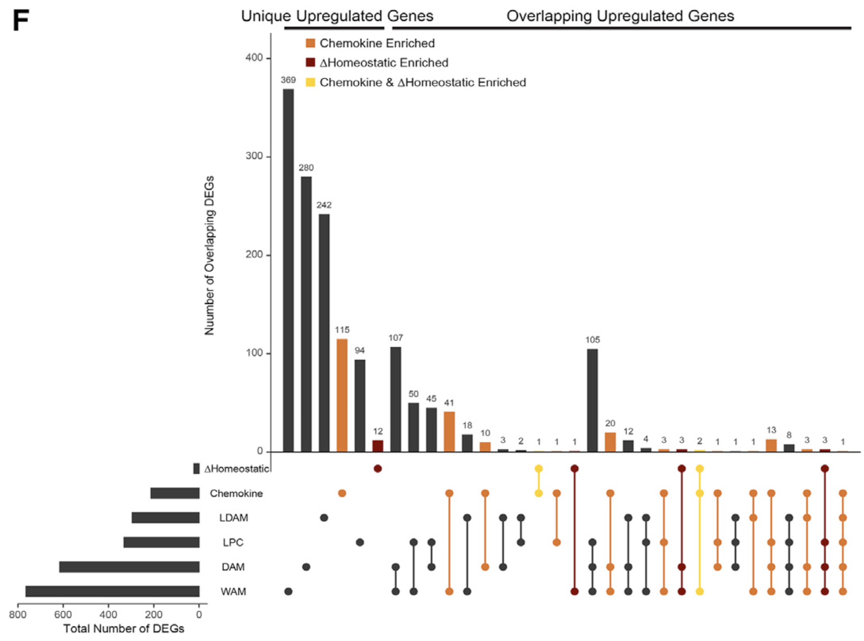
Figure 3 (cont.)
Microglial states
LDAM: Lipid droplet accumulating microglia
LPC: microglia following demyelinating injury from lysolecithin
DAM: disease associated microglia
WAM: WM associated microglia
Notes:
Fig 3F:
Compared chemokine and homeostatic cluster’s gene signatures to pathology-specific reactive microglial states
Comparing the intersections between the upregulated genes from chemokine/homeostatic microglia clusters and genes upregulated in other microglial states, both signatures showed greatest similarity to WAM and DAM states

Slide 16
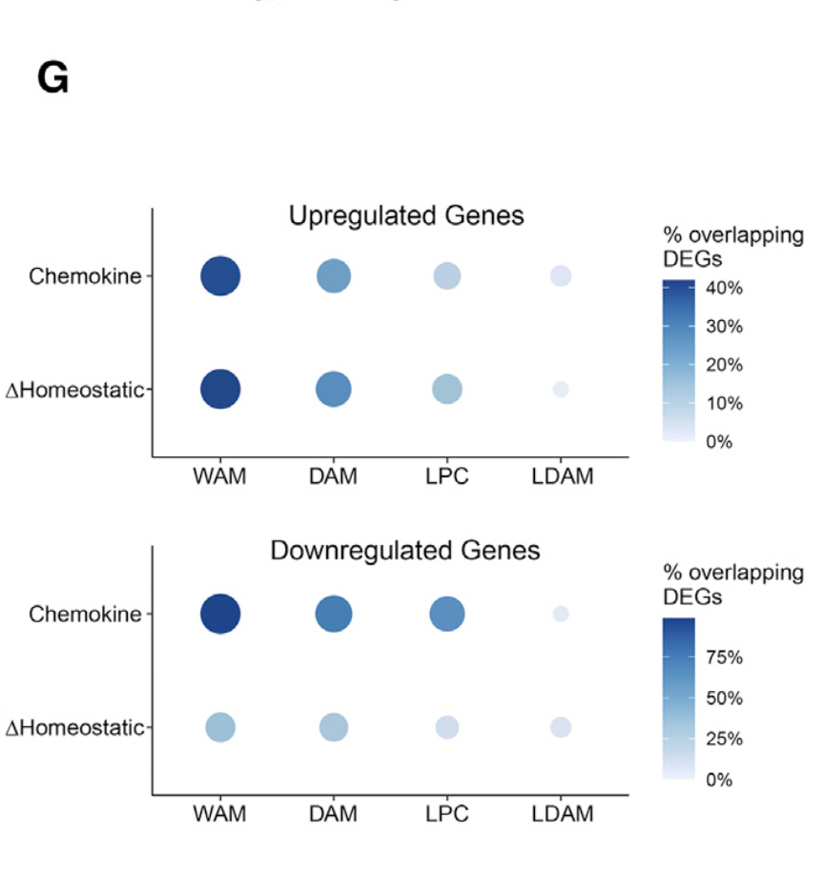
Figure 3 (cont.)
Microglial states
LDAM: Lipid droplet accumulating microglia
LPC: microglia following demyelinating injury from lysolecithin
DAM: disease associated microglia
WAM: WM associated microglia
Notes:
Fig 3G (same context as 3F):
Similarity of these gene expression changes to white matter aging and injury is consistent with increased microglial reactivity in the subcortical white matter following covid infection
One thing to note: previously described microglial states in other disease contexts don’t completely encompass covid-related transcriptional changes, highlighting aspects of a distinct state of microglia/myeloid cell reactivity following mild respiratory covid

Slide 17
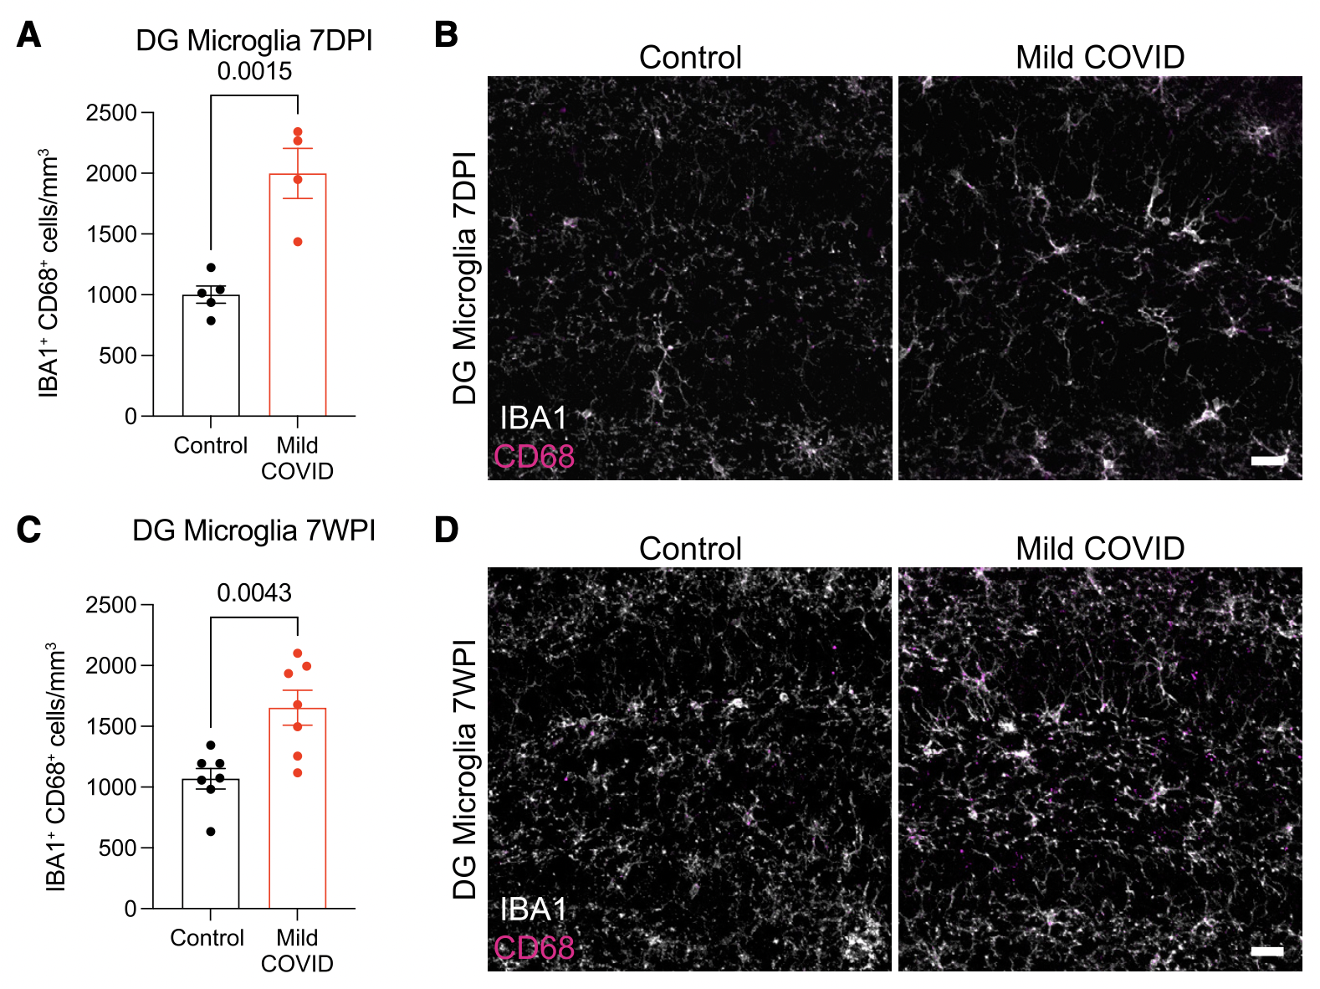
Figure 4. Decreased hippocampal neurogenesis after mild respiratory COVID
↑ IBA1/CD68
=
↑ Microglia Activation
Notes:
Mild respiratory covid impairs hippocampal neurogenesis
Fig 4ABCD: robustly increased microglial/macrophage reactivity in hippocampal WM at 7 days post infection that persisted 7 weeks post infection
A: Reactive microglia (IBA1+ CD68+) quantification 7 days post-infection (7DPI) in the dentate gyrus (hilar white matter) (n = 5 control, n = 4 mild COVID mice).
Fig 4EFGH
Consistent with previous observations that reactive microglia can inhibit hippocampal neurogenesis, a stark decrease in new neuron generation wa evident (assessed by doublecortin positive cell quantification)

Slide 18
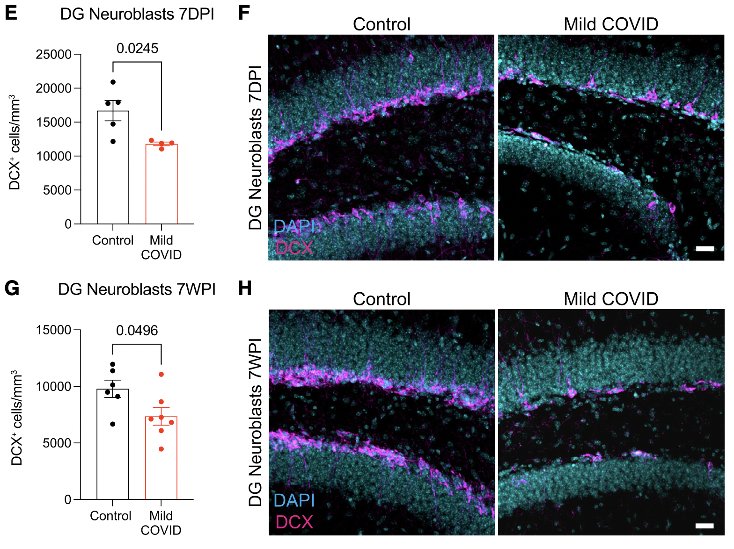
Figure 4 (cont.)
↓ DCX
=
↓ Neurogenesis
Notes:
DAPI: used to determine number of nuclei / gross cell morphology
Neuroblast (DCX): marker of neurogenesis
Fig 4EFGH
Consistent with previous observations that reactive microglia can inhibit hippocampal neurogenesis, a stark decrease in new neuron generation wa evident (assessed by doublecortin positive cell quantification)
Reduced magenta = less neurogenesis
Considering the number of newly generated hippocampal neurons as a function of the reactive microglial load, we find an inverse correlation between neurogenesis and reactive microglia in the hippocampus

Slide 19
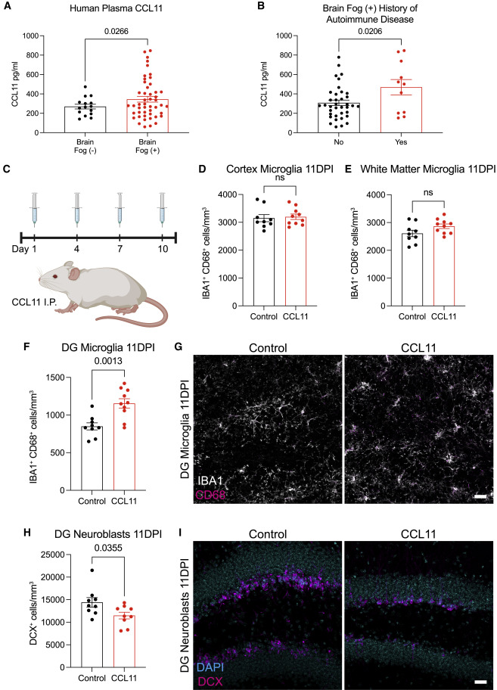
Figure 5. Elevated CCL11 levels associated with cognitive impairment induce hippocampal dysregulation
↑ CCL11 in human plasma in individuals presenting brain fog
History of autoimmune disease = ↑ CCL11
Notes:
Impaired attention, concentration, speed of information processing, memory, and executive function
Most typical pattern of cognitive dysfunction associated with cancer-therapy-related cognitive impairment (CRCI) are memory loss, slowed processing speed, and executive dysfunction
Measured CCL11 because it contributes to cognitive impairment and limits neurogenesis
Examined circulating CCL11 cytokine levels in the plasma of people suffering from long COVID with and without cognitive symptoms; CCL11, a chemokine associated with cognitive impairment in aging; found significant elevation of ccl11 between individuals with brain fog vs those without; sample size = 48 human subjects with brain fog and without n = 15 human subjects without brain fog
Multiple linear regression = relationship between a quantitative dependent variable and two or more independent variables using a straight line; found that patients with a history of autoimmune disease presented higher levels of CCL11 compared to those without autoimmune disease history (why wasn’t this controlled for? How many patients had autoimmune disease? What kind of autoimmune disease?)

Slide 20
Figure 5 (cont.)
Injected 4 doses of CCL11 I.P. in mice
No significant differences of microglia/macrophage reactivity in cortex and white matter (measured by IBA1 and CD68 markers)
Notes:
Tested effects of systemic CCL11 on microglial reactivity given significant elevation of CCL11 in mild respiratory covid mouse models and elevated CCL11 levels in people with cognitive symptoms after COVID
C. Injected mice intraperitoneally with 4 doses of CCL11 over 10 days
D and E. Measured microglial/macrophage reactivity in different areas of the brain including the cortex and white matter, but no significant differences were found in these two sections

Slide 21
Figure 5 (cont.)
↑ microglial reactivity in hippocampal white matter (measured by IBA1 and CD68 markers)
↓ hippocampal neurogenesis marked by ↓ neuroblasts (measured by DCX marker)
Notes:
F and H. However, when looking at the hippocampal white matter, including dentate gyrus microglia and neuroblasts, CCL11 induced microglial/macrophage reactivity, with an increase in microglia and a decrease in neuroblasts (decrease in neurogenesis)
G and I. Representative confocal micrographs of activated microglia (IBA1, white; CD68, magenta); representative confocal micrographs of neuroblasts (DCX, magenta; DAPI, cyan)
Dentate gyrus = first region where all sensory modalities merge together to form unique representations and memories that bind stimuli together, and thus, it plays a critical role in learning and memory

Slide 22
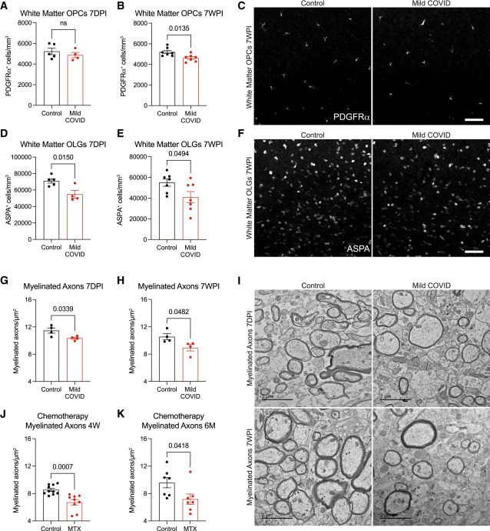
Figure 6. Oligodendrocyte and myelin loss after mild respiratory COVID
Oligodendrocyte precursor depletion (10%) after 7WPI (measured by PDGFR⍺ marker)
⅓ reduction of mature oligodendrocytes 7DPI through 7WPI (measured by ASPA marker)
Notes:
On the basis of previous knowledge that reactive microglia/macrophages can either promote or impair oligodendrogenesis, such as such as dysregulation of oligodendroglial lineage cells and loss of myelin plasticity in cancer-therapy-related cognitive impairment (CRCI) which causes a “chemo-fog” similar to “covid fog”, they examined effects of mild respiratory covid on oligodendrial lineage cells
A-C. 7 days post infection, oligodendrocyte precursor cell population was maintained (marked by PDGFRa), but 7 weeks post infection revealed a 10% decreased
D-F. When assessing mature oligodendrocytes, they found a 33% decrease a week after infection, persisting throughout 7 weeks post infection

Slide 23
Figure 6 (cont.)
↓ myelinated axon density in subcortical white matter 7DPI through 7WPI
Loss of myelin was comparable to loss of myelinated axons after methotrexate chemotherapy exposure
Notes:
Further analyses supported the loss of oligodendrocytes through the loss of myelination
G-I. Decrease in myelinated axon density in subcortical white matter (cingulum of the corpus callosum) 7DPI, persisting through 7WPI; representative transmission electron microscopy images at the level of the cingulum of the corpus callosum in cross-sectio, myelinated
axons evident as electron-dense myelin sheaths encircling axons
J and K. Loss of myelin was similar in magnitude to the loss of myelinated axons seen 4 weeks and 6 months after methotrexate chemotherapy exposure
Such persistent loss of myelin in subcortical projections would be predicted to impair neural circuit function and axon health, adding to the numerous deleterious neurobiological consequences of SARS-CoV-2 infection

Slide 24
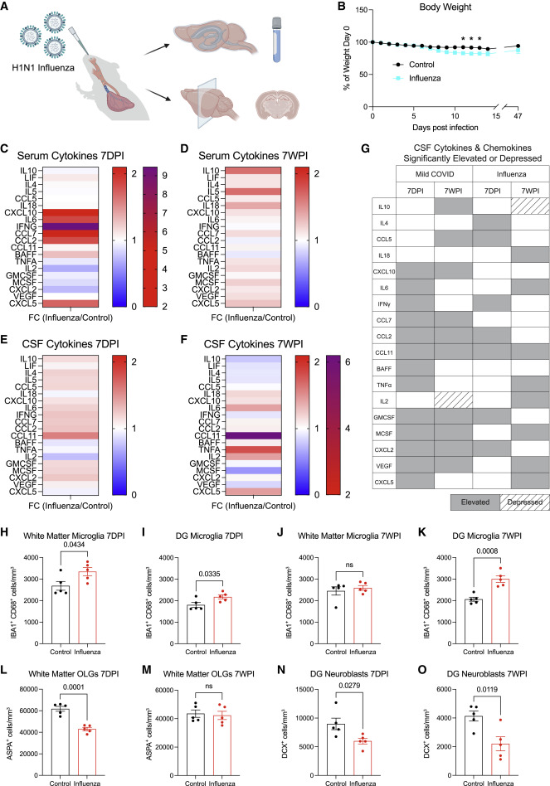
Figure 7. Comparison of neuroinflammatory response and cellular deficits following mild respiratory H1N1 influenza
Notes:
Given that other respiratory viral infections, such as influenza, are also associated with cognitive and other neurological outcomes, they compared the neuroinflammatory response to mild respiratory H1N1 influenza with SARS-CoV-2 infection
A and B. Mouse model of respiratory H1N1 influenza, which causes only minimal sickness behavior with mild (<10%) weight loss
C-F. Elevation in serum cytokines/chemokines 7DPI through 7WPI, in both serum and CSF; including IFN-g, CCL11, CCL2, and GMCSF, IL4 and CCL5; after 7WPI the only the only chemokine that remained elevated and increased from 7DPI was CCL11

Slide 25
Figure 7 (cont)
Comparison shows shared neuroinflammatory characteristics with CCL11 persistently elevated in both SARS-CoV-2 and influenza infections
Notes:
At 7WPI, a number of additional cytokines/chemokines were elevated that were not elevated at 7 days, including TNF-a, IL6, IL2, CXCL5, and IL18
Comparison of these cytokine profiles after mild respiratory infection with influenza or SARS-CoV-2 shows overlapping but distinct neuroinflammatory profiles, with the notable shared feature of persistently elevated CCL11

Slide 26
Figure 7 (cont.)
Respiratory infection with H1N1 influenza results in similar hippocampal pathology as SARS-CoV-2 infection, without lasting effects on subcortical white matter integrity
Notes:
Examined microglial/macrophage reactivity following respiratory influenza infection
H and I. Found the same pattern of white matter-selective microglial/macrophage reactivity in the subcortical and hippocampal white matter 7DPI
J. Normalized microglial reactivity in the subcortical white matter by 7 weeks
K. In contrast, microglial/macrophage reactivity persisted at 7 weeks in hippocampal white matter, a finding that is consistent with
the persistently elevated CSF CCL11 levels in covid
L and M. Concordant with this pattern of microglial/macrophage reactivity, oligodendrocytes were decreased in the subcortical whitematter at 7 days but recovered as microglial reactivity resolved by 7 weeks
N and O. Hippocampal neurogenesis was deficient at both 7-day and 7-week time points, consistent with the persistent hippocampal microglial/macrophage reactivity
In comparison to SARSCoV-2, mild respiratory infection with H1N1 influenza results in similar hippocampal pathology, but without the lasting effects on subcortical white matter integrity seen after respiratory COVID

Slide 27
Conclusions
Mild respiratory infection with SARS-CoV-2 results in persistent neuroinflammatory changes and dysregulation of neural cell types
Key dysregulations include prominent elevation of multiple cytokines and chemokines (particularly CCL11), lasting reactivity of white matter microglia in subcortical and hippocampal regions along with impaired hippocampal neurogenesis, dysregulation of the oligodendroglial lineage and myelin loss
Together, these contribute to the “COVID fog” with characteristics similar to those of CRCI

Slide 28
Questions?

